Slide 1
Experiment “Prep Talk”
CAU - Polariton
Silas Oettinghaus

Slide 2
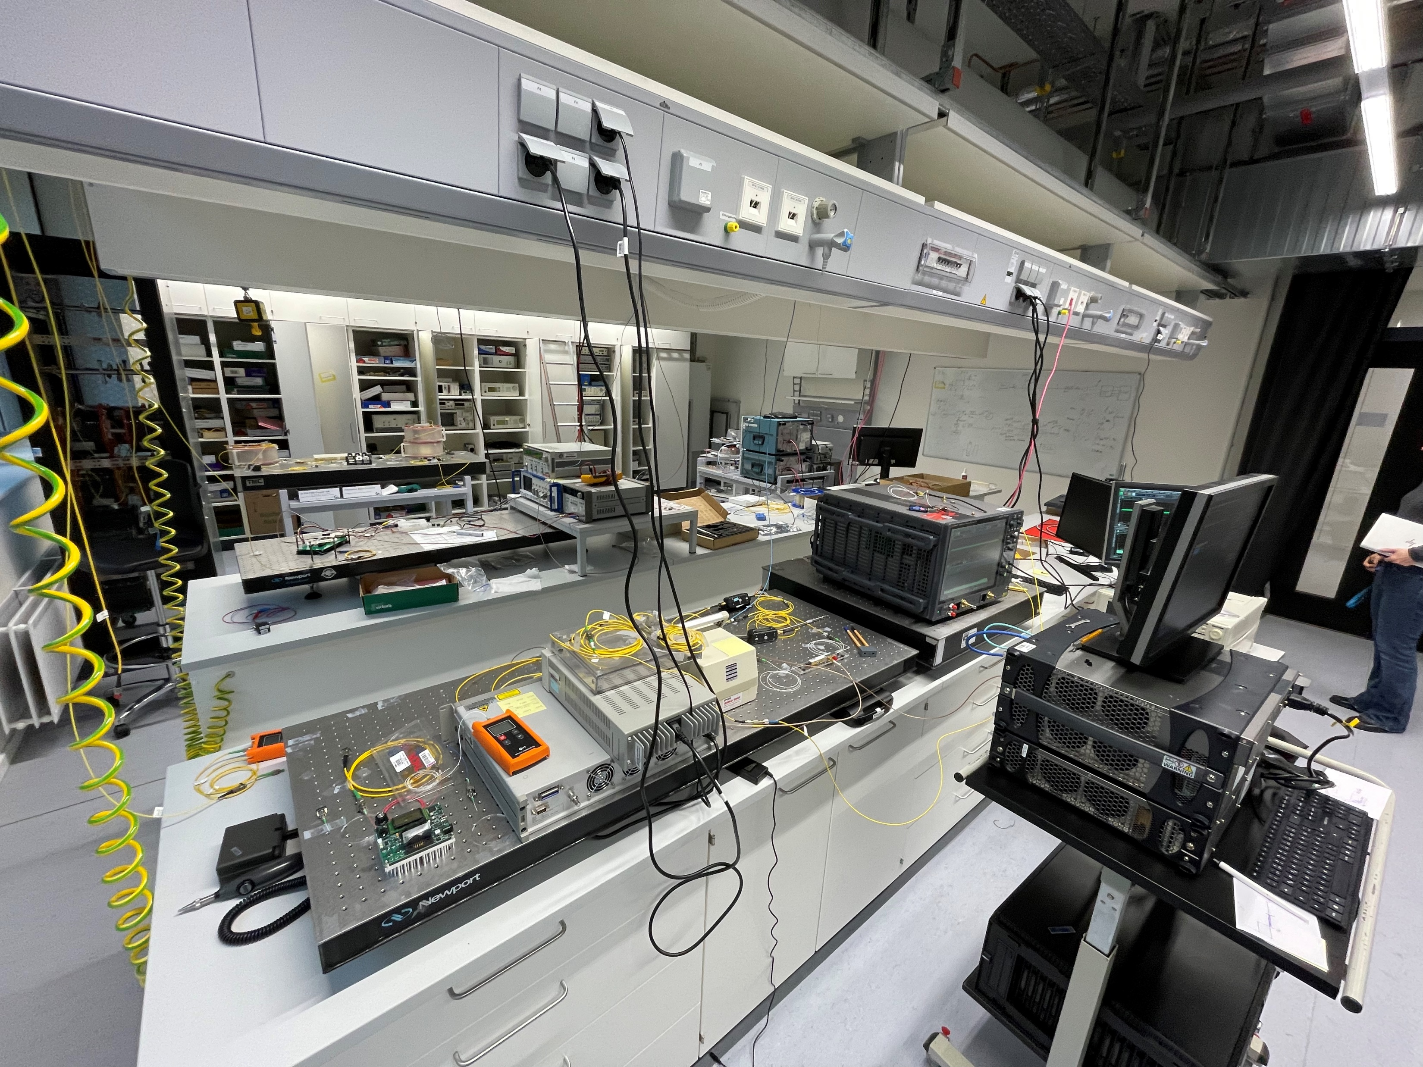
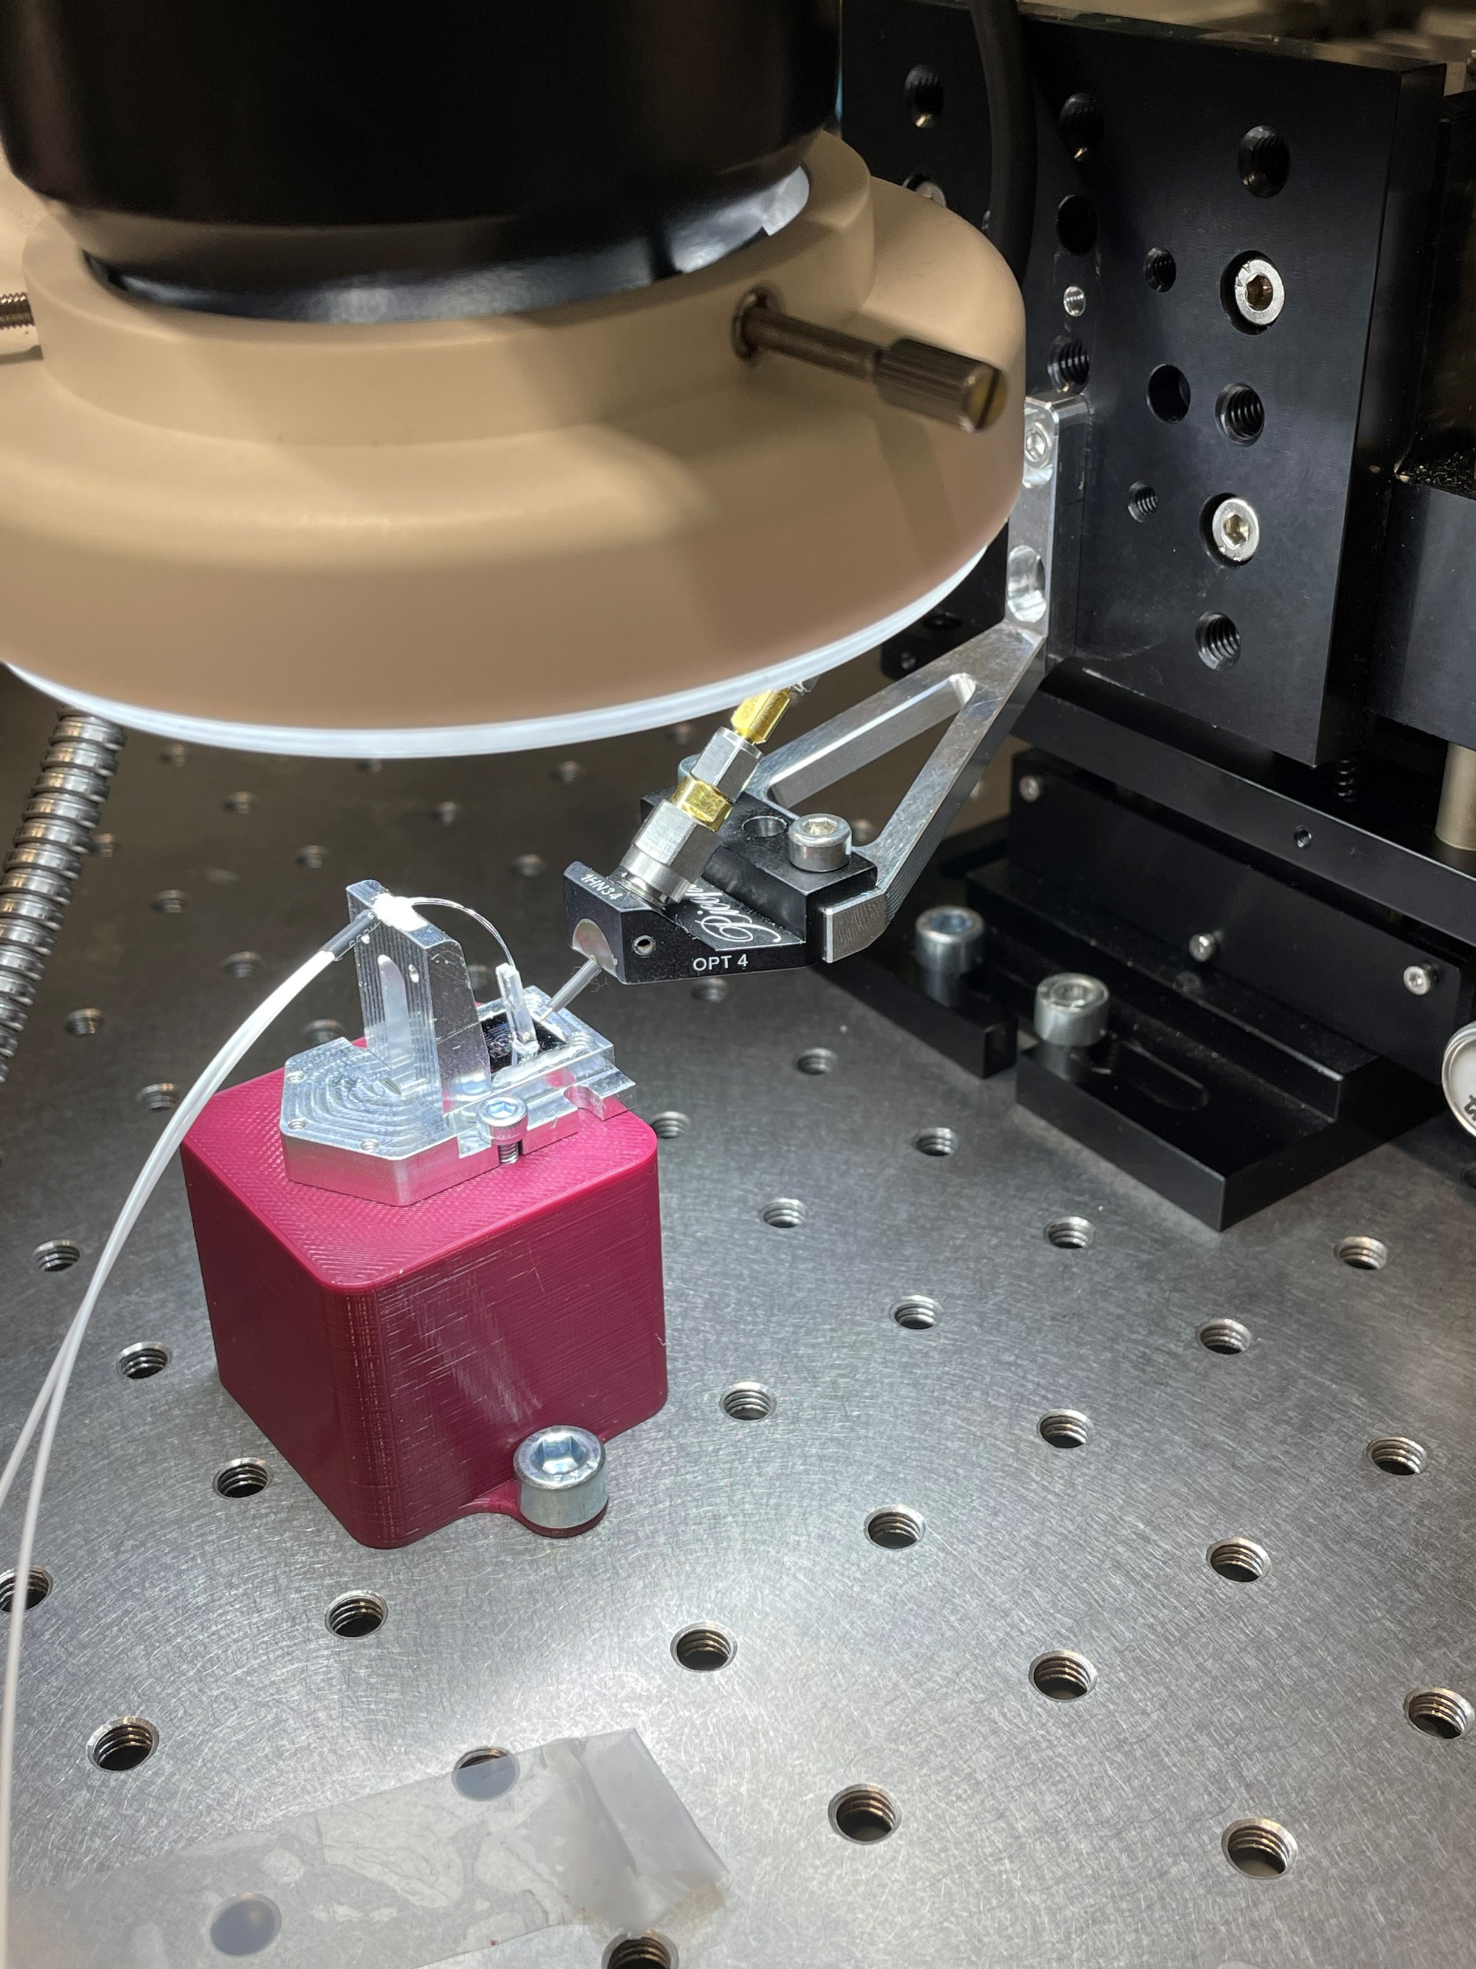
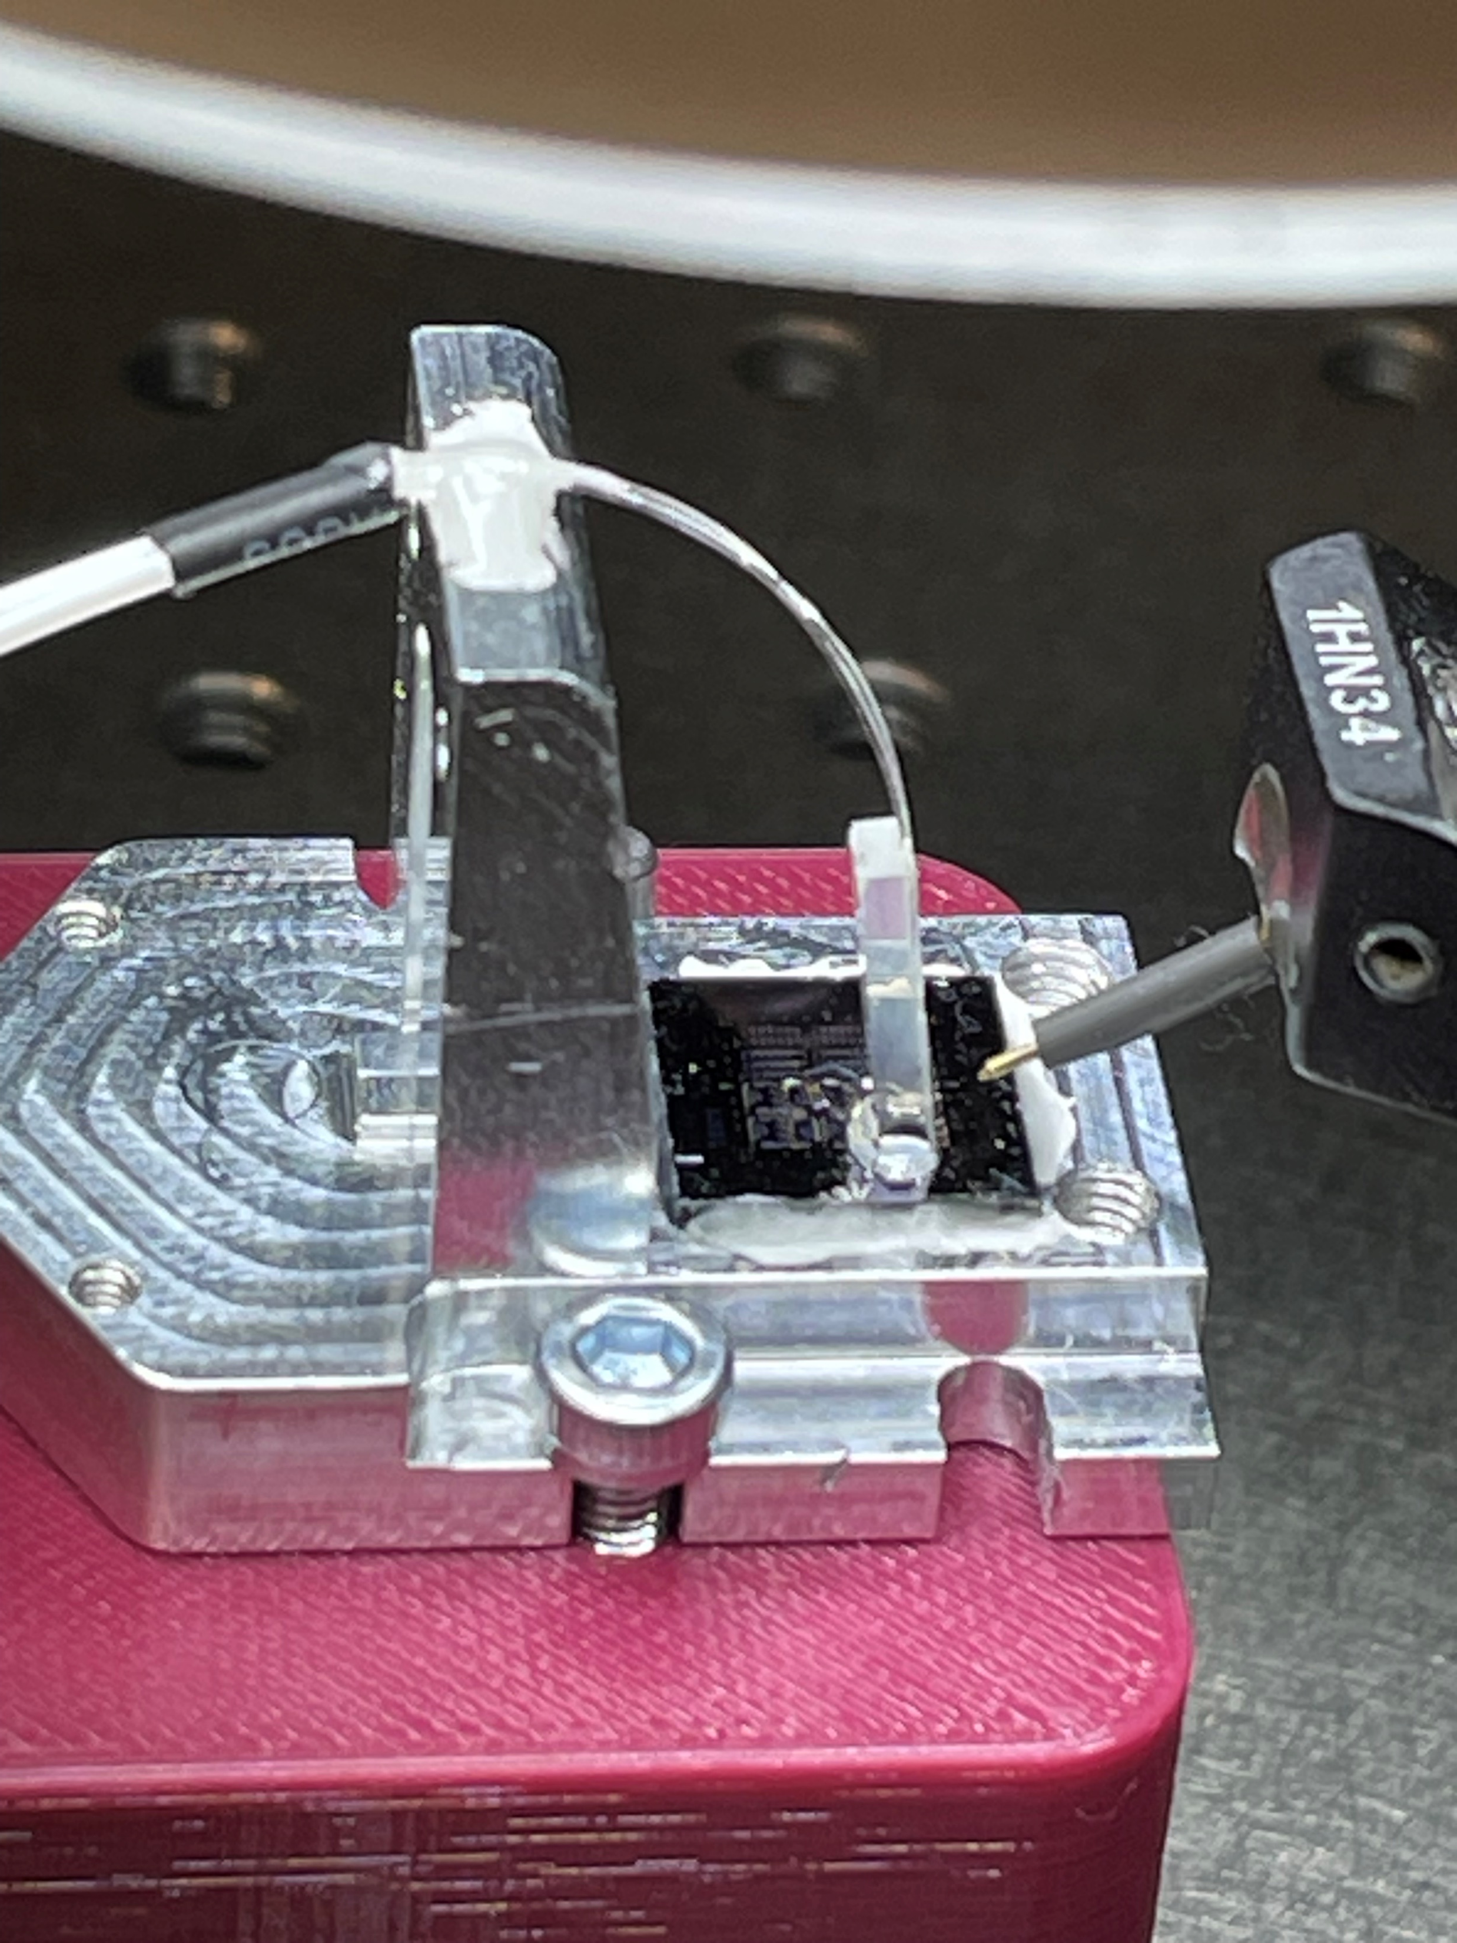
Modulator Characterization
Bias optimization
  Stability of bias (Temp., Pol., Drift, …)
  Influcence of bias on BER
Transmission Experiment

Slide 3
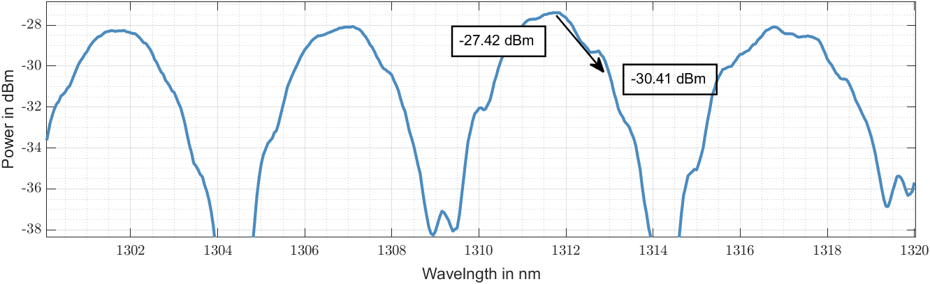
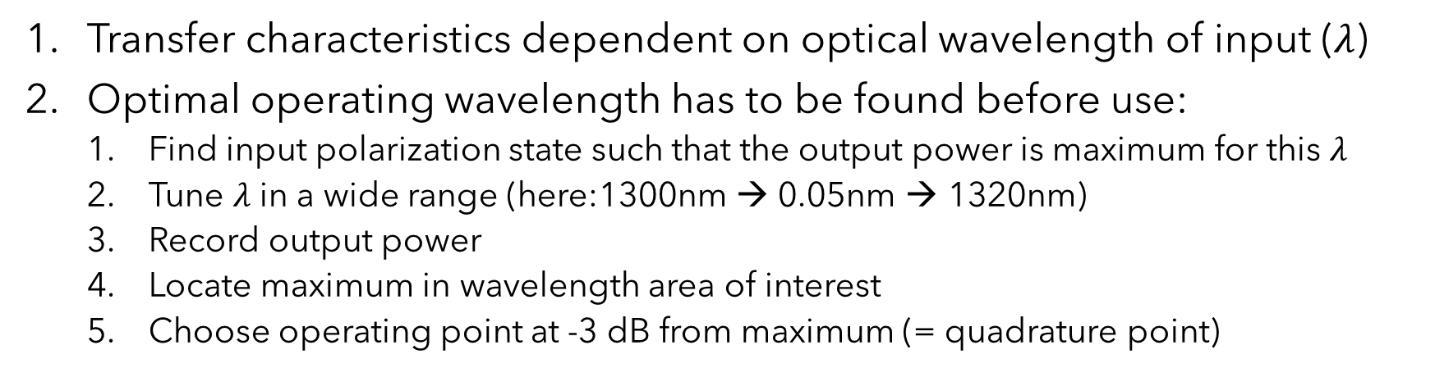
Modulator Characterization
Transfer characteristics dependent on optical wavelength of input ($λ$)
Optimal operating wavelength has to be found before use:
  Find input polarization state such that the output power is maximum for this $λ$
  Tune $λ$ in a wide range (here:1300nm → 0.05nm → 1320nm)
  Record output power
  Locate maximum in wavelength area of interest
  Choose operating point at -3 dB from maximum (= quadrature point)

Slide 4
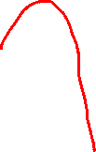
Setup for Modulator Characteristics Measurement
Pol.
Control
Tunable Laser
(ECL, Tunics T100)
Modulator
Keysight
Attenuator/PM
N7764A
Up to 10 dBm
Tunable in 0.01 nm steps

Slide 5
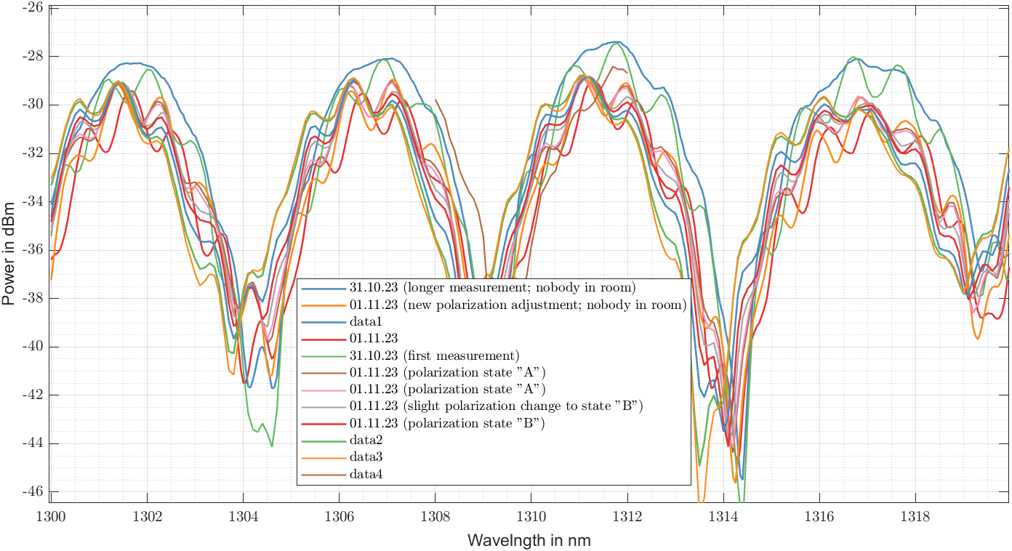
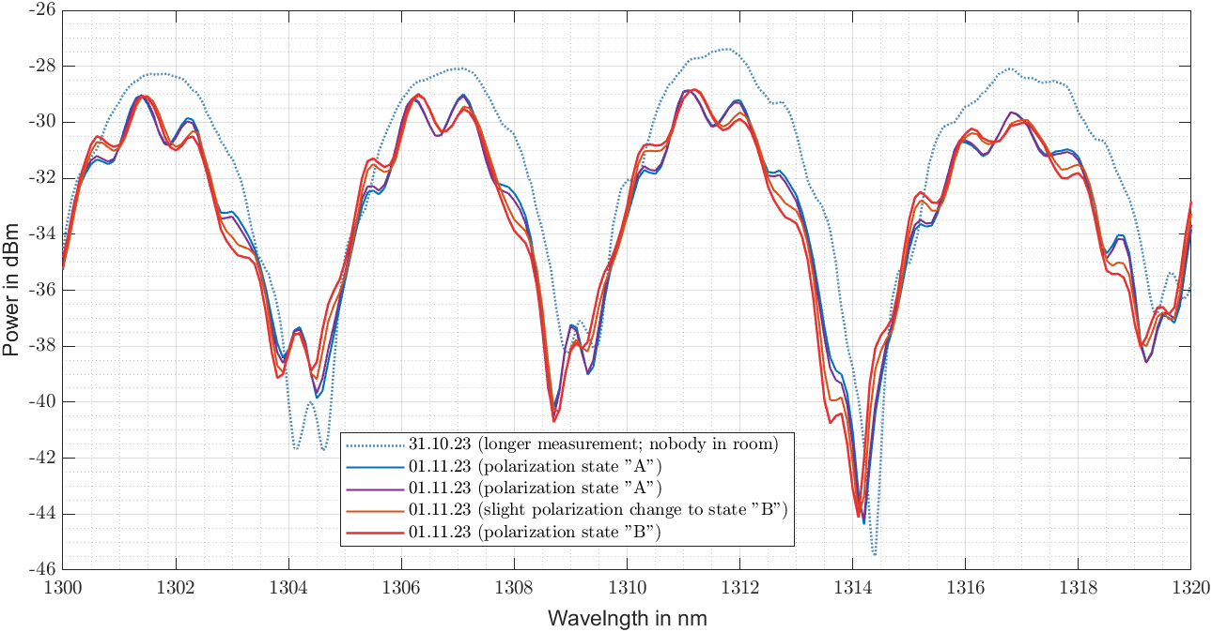
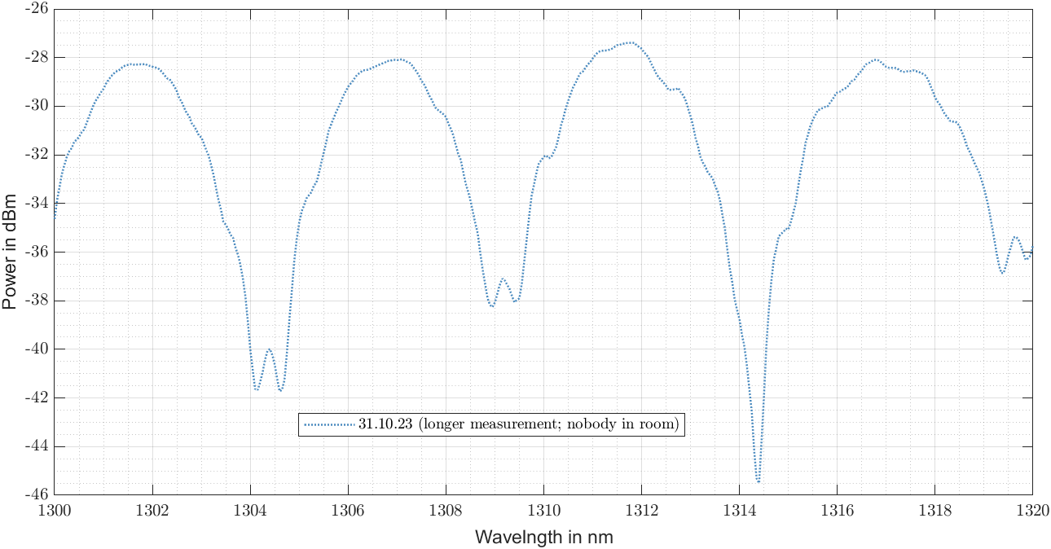
Transfer Characteristics 3 / 3

Slide 6
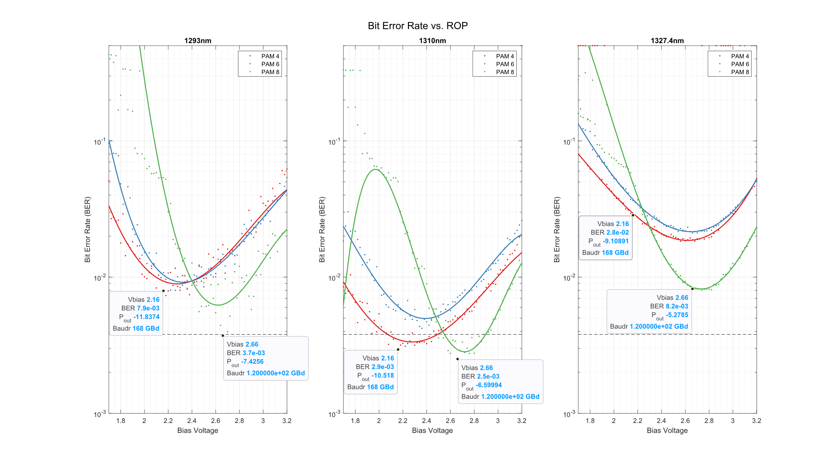

Bias Optimization (Example)
PAM 4
PAM 6
PAM 8
Wants linearity
Wants extinction

Slide 7
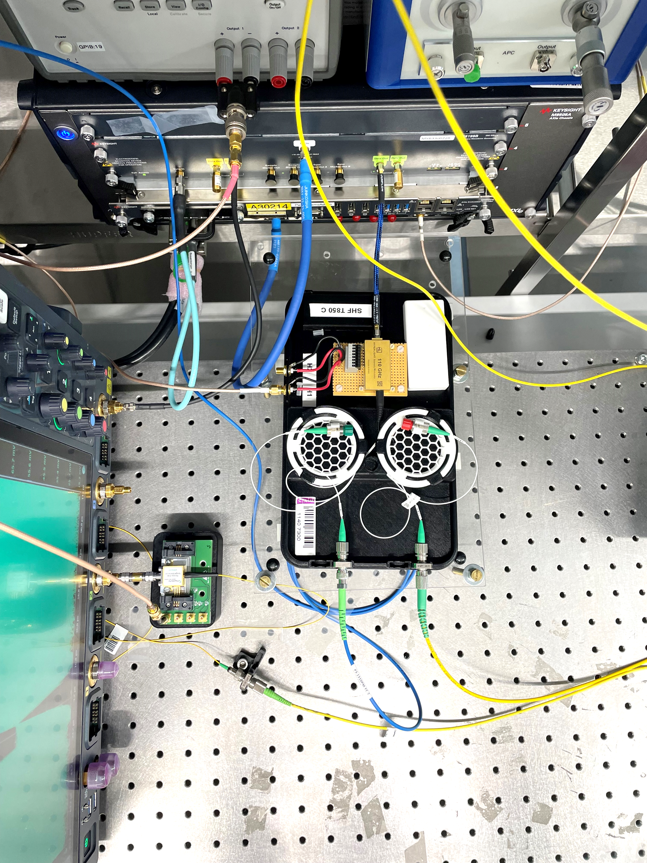
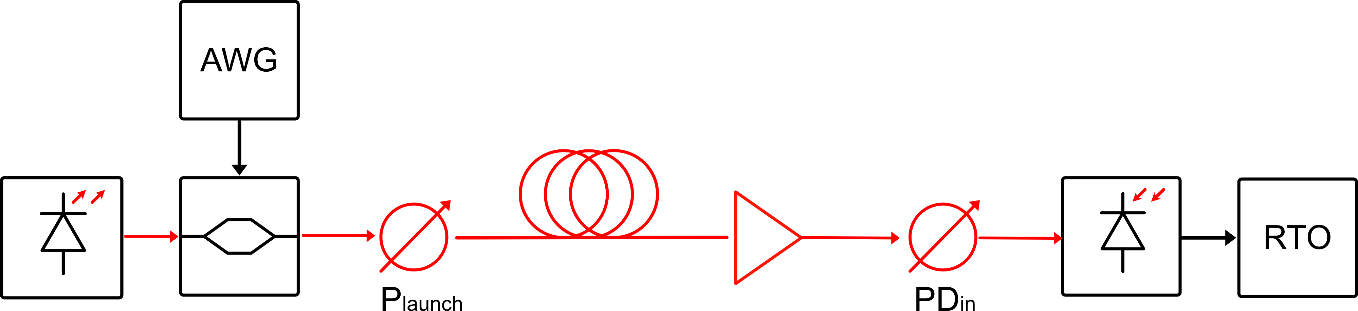
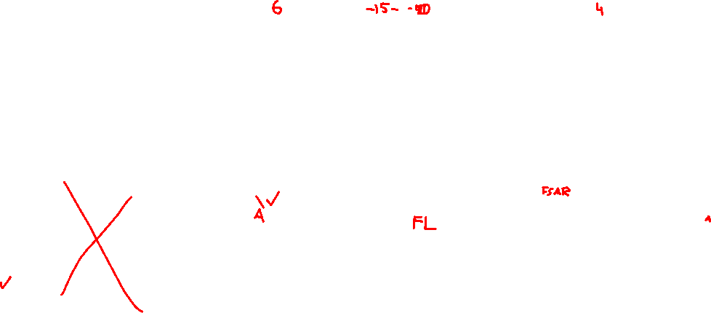
Kiel University Equipment
256 Gsa/s
256 Gsa/s
10 dBm
O-band tunable
110 GHz
-10 dB IL
3.2 V Vpi
PDFA
70 GHz
Laser | Modulator | AWG | Fiber | PDFA | PD | Scope
EXFO OSICS T100 External Cavity Laser | Hyperlight O-Band TFLN | Keysight M8199B | SSMF 1-10 km | Thorlabs PDFA100 | Fraunhofer PIN Single Ended | Keysight UXR1104B
1292nm,…,1327nm 10 dBm | 110 GHz 3.2 V Vpi 10 dB IL | 256 Gsa/s | ZDW ~1310 nm |  | 70 GHz | 110 GHz

Slide 8
Setup for High-Speed Transmission
256 GS/s
80 GHz bandwidth
AWG Keysight M8199B
256 GS/s
110 GHz bandwidth
Probe
Pol.
Control
Tunable Laser
(ECL, Tunics T100)
Modulator
PM
Tunable Optical
Bandpass Filter
PM
PIN
Photo Diode
Scope
Keysight
UXR 1102A
PDFA
SOA
Up to 10 dBm
Tunable in 0.01 nm steps
70 GHz
bandwidth
10%
OSA
Mainly used to adjust center frequency of OBF
PM: Eigenlight power meter + tunable attenuator

Slide 9

75
-10 dB @ 75 GHz
-20 dB @ 92 GHz
-30 dB @ 101 GHz
448 Gbps
224 GBd PAM 4 = 112 GHz
180 GBd PAM 6 = 90 GHz
150 GBd PAM 8 = 75 GHz
90
112

Slide 10
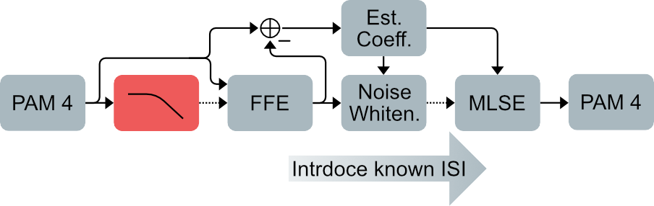
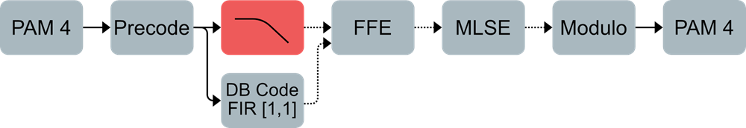







DSP Structure (during experiment)
VNLE + PF + MLSE
„Full“ pre compensation
DB precoded
Low or no precompensation
DB encoded
„Full“ pre compensation
Maintains high Vpp
wants linear bias in quadr. point

Slide 11
